Slide 1
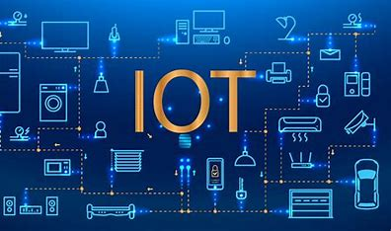

HAND GESTURES CONTROLING SYSTEM
Presented By
1.G.arnitha (21R21A0586)
2.g.riya (21R21A0594)
3.a.charan sai (21R21A0569)
4.e.ranadheer (21R21A05B3)

Slide 2
AGENDA
Abstract
Literature Survey
Problem Identification
Existing System
Proposed System
Block Diagram
System Requirements
Functional & Non Functional Requirements
Action Plan

Slide 3
ABSTRACT
The principle behind the Arduino based Hand Gesture Control of Computer is actually very simple. All you have to do is use two Ultrasonic Sensors with Arduino, place your hand in front of the Ultrasonic Sensor and calculate the distance between the hand and the sensor. Using this information, relevant actions in the computer can be performed. The position of the Ultrasonic Sensors is very important. Place the two Ultrasonic Sensors on the top of a laptop screen at either end. The distance information from Arduino is collected by a Python Program and a special library called PyAutoGUI will convert the data into keyboard click actions.

Slide 4
LITERATURE SURVEY:
TEAM: 11
S.NO | TITLE OF THE PAPER | AUTHOR NAMES | TECHNOLOGY USED | ALGORITHM | ADVANTAGES | DISADVANTAGES
1 | Arduino Based Hand Gesture Control of Computer. | Ayushi Bhawal, Debaparna Dasgupta, Arka Ghosh, Koyena Mitra | The parts consisting Arduino Microcontroller, the ultrasonic sensors HC-SR04 and a pc, the software used is Arduino IDE and Python 3.8.2 IDLE | _ | The result is not influenced by colour or transparency of objects.,dust,dirt,high moisture and can be used in dark environments. | Low robustness as there are various markers on the body. Computational complexity and calibration difficulties.
2 | Real-Time Hand Gesture Recognition Based on Deep Learning YOLOv3 Model. | Abdullah Mujahid, Mazhar Javed Awan, Awais Yasin, Mazin Abed Mohammed, Robertas Damaševicius, Rytis Maskeliunas, Karrar Hameed Abdulkareem | It uses geometric called Bezier curves for trajectory analysis and classification of gestures. calculate correct gesture from trajectories with variations in hand speed. | _ | The method has high accuracy rate and has correct hand identification rate up to 95.6%. | Alterations due to minor movement or noise around the hand area leads to incorrect detection of gesture.
3 | Robust Part-Based Hand Gesture Recognition Using Kinect Sensor. | Zhou Ren, Junsong Yuan, Jingjing Meng, Zhengyou Zhang | Uses kinetic and depth sensor to identify complex articulate hand gestures. | _ | Due to its versatility, size and optimum cost it can be used throughout the day. Kinect sensor | Depth sensor has range limitation so with increment, at an amount of 1cm the detection accuracy decreases.The sensor has limited 58- degree field of view.

Slide 5

Problem identification
As Technology increasing day by day people are getting attracted and also habituated to those technologies and making themselves lazy,

Slide 6
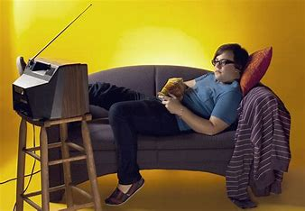
Existing system
The problem in the existing system in many areas like where people are
Lazy of operating gadgets physically.

Slide 7
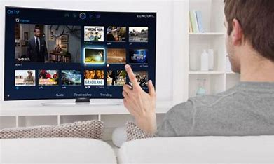
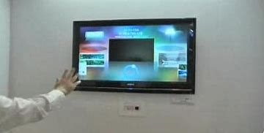
Proposed system
The person is able to control the gadgets with his/her hand gestures for different functionalities of different gestures,

Slide 8
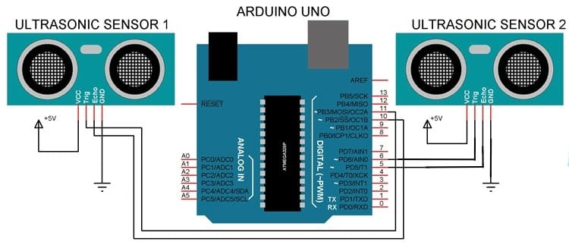
BLOCK DIAGRAM :

Slide 9
System Requirments:
Hardware :
Software :
Arduino UNO
Ultrasonic Sensor X2
Bread Board
Jump wires
Arduino IDE
PyCharm

Slide 10
Functional & Non-Functional Requirements
Functional Requirements :
NON - Functional Requirements:
Object should be within the range of the sensor.
Intensity of the sensor should be 1meter range.
Sensor should detect only human guestures.
Light should blink as per the gestures recognised.
Gesture response should be less than 1 second i.e about 80 milliseconds.

Slide 11
Action plan
Planning And Requirement Analysis
Defining Requirements
Designing Architecture & Program
Linking & Testing the project
Maintaining the Project

Slide 12


